Slide 1
Membership Overview
Find the latest version of this deck in your LFX Organizational Dashboard.

Slide 2
Antitrust Compliance Notice
Open Mainframe Project meetings involve participation by industry competitors, and it is the intention of the Open Mainframe Project to conduct all of its activities in accordance with applicable antitrust and competition laws. It is therefore extremely important that attendees adhere to meeting agendas, and be aware of, and not participate in, any activities that are prohibited under applicable US state, federal or foreign antitrust and competition laws.
Examples of types of actions that are prohibited at Open Mainframe Project meetings and in connection with Open Mainframe Project activities are described in the Linux Foundation Antitrust Policy. If you have questions about these matters, please contact your company counsel, or if you are a member of the Open Mainframe Project, feel free to contact Andrew Updegrove of the firm of Gesmer Updegrove LLP, which provides legal counsel to the Open Mainframe Project.

Slide 3





Vision
The mainframe is an active, integrated, and essential part of modern enterprise IT, consumable by mainstream developers and users, and driven by a vibrant open source community.
Mission
To achieve the vision of the Open Mainframe Project by…
The Open Mainframe Project was founded in 2015, as a focal point for deployment and use of Linux and Open Source in a mainframe computing environment.
Open Source is the collective thread within leading organizations that look to leverage their technology infrastructure as a competitive advantage. The mainframe design principles of security, stability, scalability, and performance are important to these leading organizations, and having the mainframe interoperable in a hybrid infrastructure enables leading organizations to realize its benefits. Open Mainframe Project believes this is best achieved as a community through open source.
Open Mainframe Project hosts 17 projects and working groups and is supported by 40 organizations.
Setting a high bar for application development on the mainframe
through documentation, API development, and a security-first approach.
Showcase the mainframe of today
to both the mainframe ecosystem as well as the broad enterprise IT community.
Enable the mainframe to be more consumable by developers
with a transparent experience in leveraging the value propositions of the mainframe.
Ensure the mainframe aligns well in the changing enterprise IT landscape
of cloud-native and DevOps.
Notes:
The mission of the Open Mainframe Project is to build that community and adoption of Open Source on the mainframe, which will ( read points above )
Image from https://www.openmainframeproject.org/about

Slide 4














Open Mainframe Project: part of The Linux Foundation ecosystem of sustainable open source
For the last 16 years, The Linux Foundation has provided unparalleled support for open source communities through financial and intellectual resources, governance structure, IT infrastructure, services, events, and training.
Dedicated to building sustainable ecosystems around open source projects, The Linux Foundation is working with the global technology community to solve the world’s hardest problems through open source and creating the largest shared technology investment in history.
The Linux Foundation is the umbrella organization for more than 1000 open source projects accelerating open technology development and commercial adoption. Some of the game-changing initiatives hosted by The Linux Foundation include:
Notes:
See more details here: https://www.linuxfoundation.org/join/#benefits

Slide 5
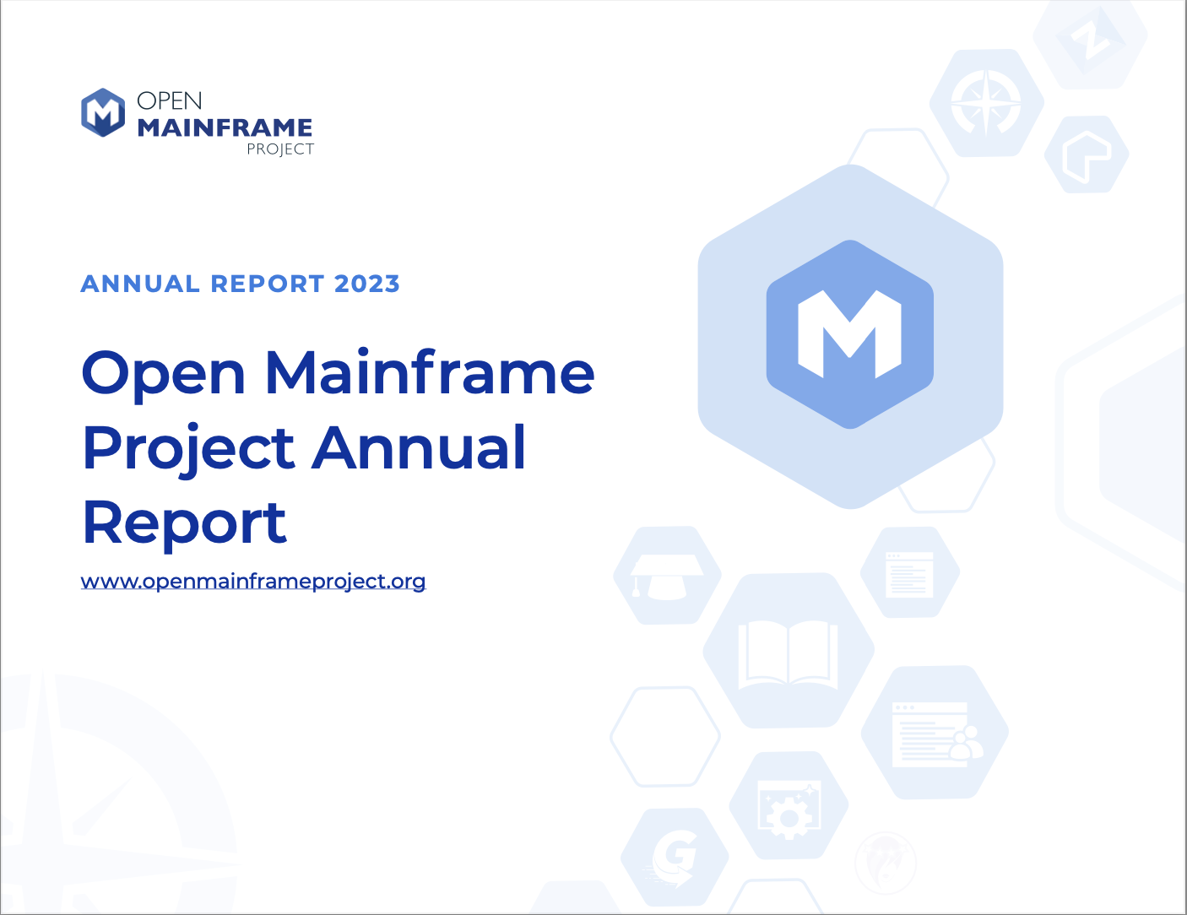
Check out the 2023 Annual Report for more!
Our fourth annual report showcases the amazing impacts the Open Mainframe Project has had in driving innovation through collaborative development, with a look to 2023.
Download and share with your colleagues and networks!
openmainframeproject.org/annual-report/2023

Slide 6
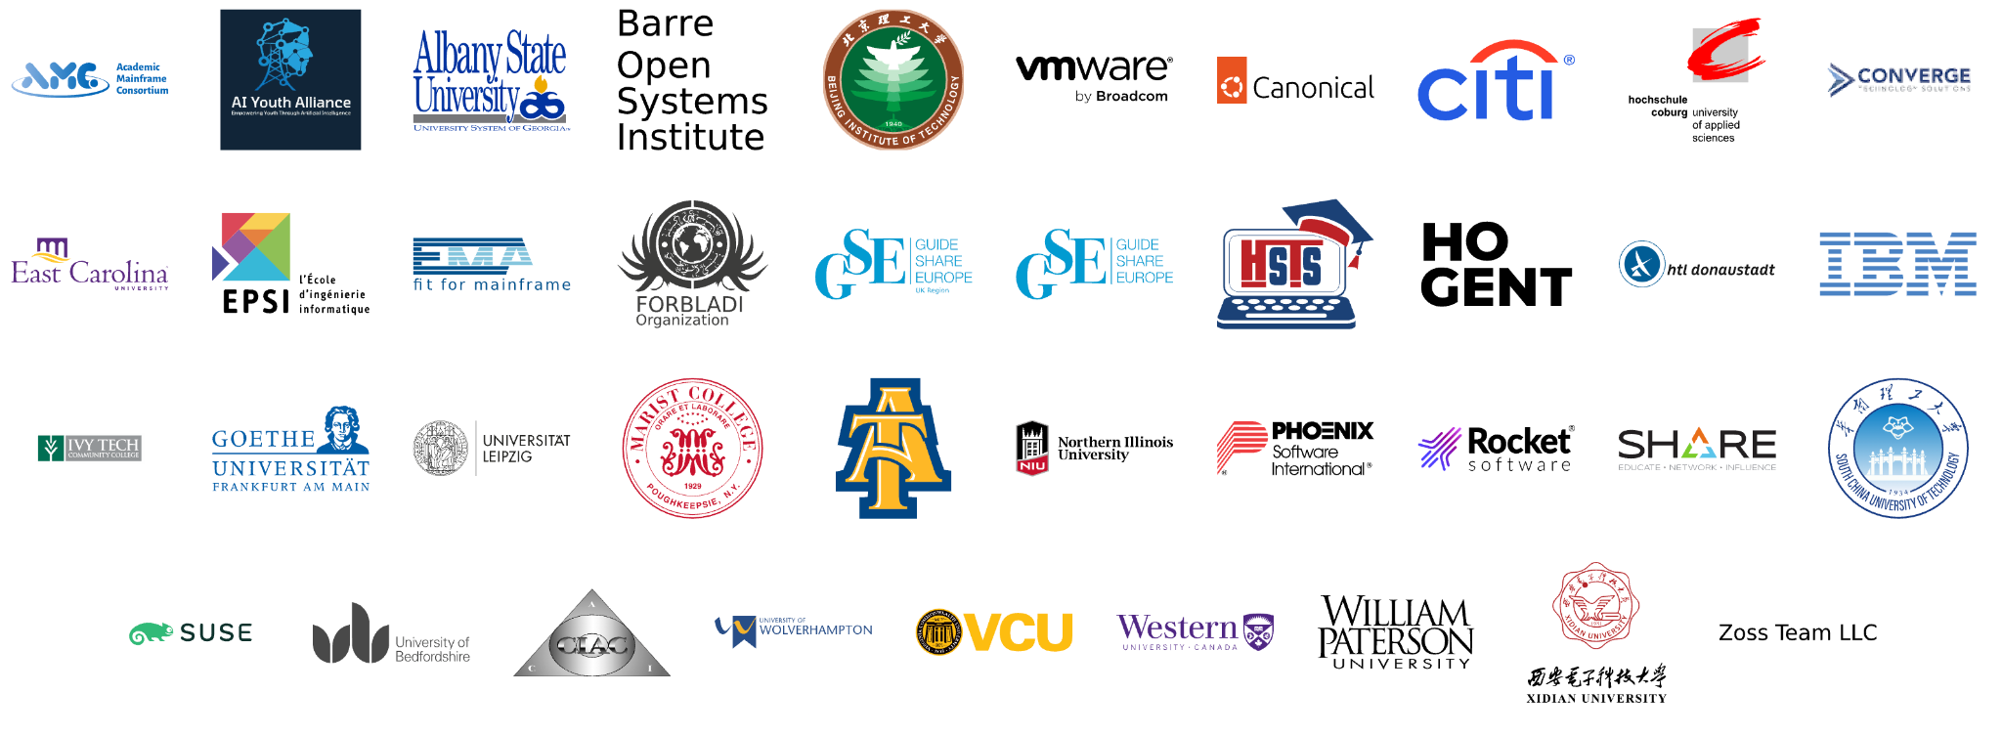
Member Organizations
Learn more about membership at openmainframeproject.org/join
Notes:
Source: https://landscape.openmainframeproject.org/embed/embed.html?base-path=&classify=category&key=open-mainframe-project-member-company&headers=false&category-header=true&category-in-subcategory=false&title-uppercase=false&title-alignment=center&title-font-family=sans-serif&title-font-size=13&style=clean&bg-color=%230033a1&fg-color=%23ffffff&item-modal=false&item-name=false&size=md&items-alignment=center

Slide 7
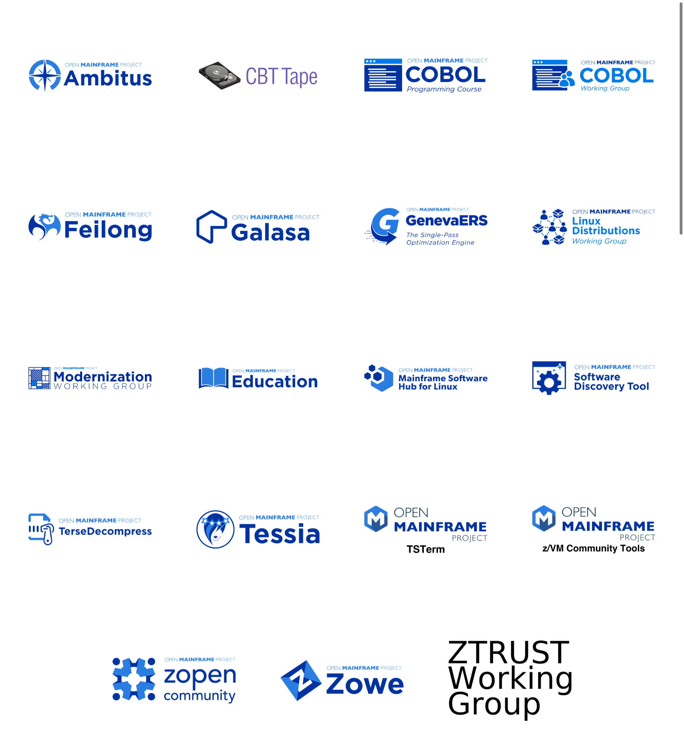
Open Mainframe Project enables this innovation
Learn about all Open Mainframe projects at openmainframeproject.org/our-projects/
Notes:
Open Mainframe Project enables this innovation as a host of 16 projects and working groups that are part of closing the gap.
Source: https://landscape.openmainframeproject.org/embed/embed.html?base-path=&classify=category&key=open-mainframe-project-projects&headers=false&category-header=false&category-in-subcategory=false&title-uppercase=false&title-alignment=left&title-font-family=sans-serif&title-font-size=13&style=clean&bg-color=%230033a1&fg-color=%23ffffff&item-modal=false&hide-organization-section=false&item-name=false&size=lg&items-alignment=center&items-spacing=0

Slide 8
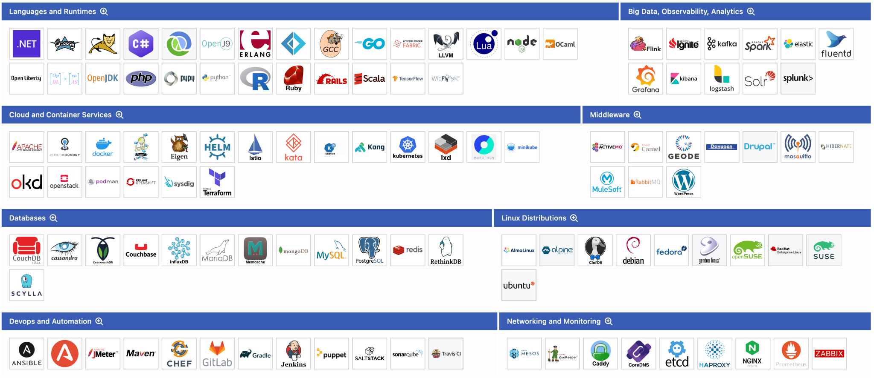
Broad Open Source Supported on Mainframe
Source: landscape.openmainframeproject.org/open-source-ecosystem
Notes:
Further, the open source community on mainframe is ensuring broad open source is supported on mainframe, which is the key piece for forward thinking organizations to realizing the mainframe’s benefits in their computing infrastructure.
Source: https://landscape.openmainframeproject.org/open-source-ecosystem

Slide 9
Open Mainframe Project Governance at a glance
Cross-project collaboration
Project Lifecycle Management
Developer Voice to GB
Technical Advisory Council (TAC)
Open Mainframe Project
Governing Board
Strategy & Priorities
Budget
Marketing Strategy & Events
Legal & overall governance
Marketing Committee
Zowe
ADE
Mentorship
Zorow
etc
Annual Marketing Plan
PR
Events
Content/Web
Branding
Market Development
Developer Communities
The Linux Foundation Internal Use Only

Slide 10
Governing Board
Comprised of one voting representative from each Platinum Open Mainframe Project member, 1 annually elected Silver member representative per 10 Silver members, 1 annually elected Academic member representative per 10 Academic members, the TAC Chairperson, and attended by the Marketing Committee Chair, the Governing Board’s responsibilities include:
Approving a budget
Electing a Chair to preside over Governing Board meetings, authorize expenditures approved by the budget and manage any day-to-day operations
Overseeing all Project business and marketing matters
Current Governing Board members listed at https://www.openmainframeproject.org/about/governing-board
Notes:
Only for Premier members

Slide 11
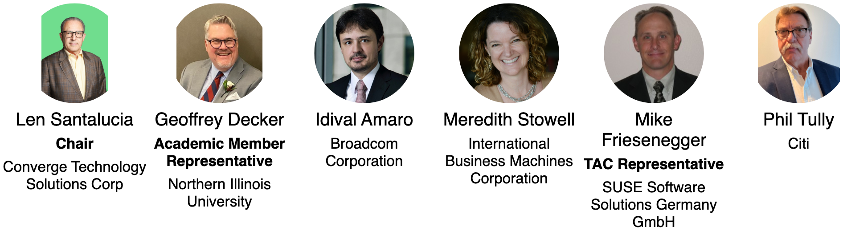
Governing Board Representatives
Notes:
https://jmertic.github.io/committee-gallery/open-mainframe-project-governing-board.html

Slide 12
Open Mainframe Project - OKRs 2026
O1 - Grow partnerships with key industry events and groups.
KR1 - Continue having a track as GS UK and Community Day at IBM TechXchange, increasing session submissions and attendees to talks by 10%.
KR2 - Partner with SHARE on a track that features Open Mainframe Project initiatives and open source on the mainframe.
KR3 - Sponsor VM Workshop and increase sessions featuring Open Mainframe Project initiatives, and open source on the mainframe by 10%.
KR4 - Continue work with MSCS, growing the amount of content related to diversity in the mainframe industry by 10%
O2 - Strengthen technical initiatives and support for broad open source projects on the mainframe
KR1 - Leverage new mainframe infrastructure to offer open source communities CI/CD/testing infrastructure for their projects
KR2 - Create a tighter alignment between Ambitus, Software Discovery Tool, Linux Distributions WG, zopen community, and Mainframe Software Hub for Linux to enable cooperation in making open source tools supported and available across z/OS and Linux s390x.
KR3 - Increase contributions, organizations, and contributors across all projects by 10%
O3 - Strengthen organizational engagement
KR1 - Add 1 new Platinum member and 5 Silver members
KR2 - Publish 10 customer/vendor references speaking to how they leverage Open Mainframe Project technical work
KR3 - Develop an end-user advisory group with five customers.

Slide 13
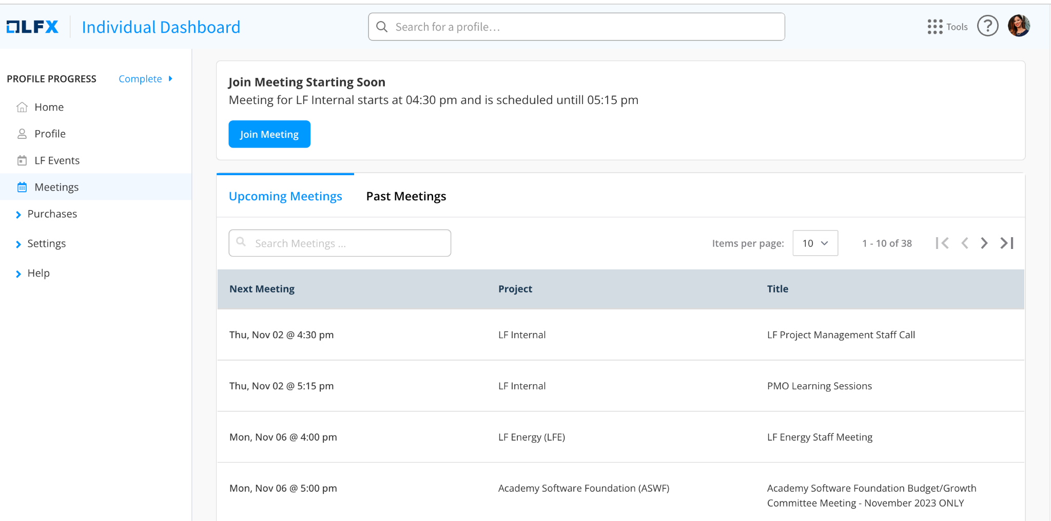
2026 Governing Board meeting schedule
All meetings from 2:00pm - 3:30pm US Eastern time unless noted.
February 11, 2026
May 13, 2026
August 12, 2026
November 11, 2026
Meeting will be on your calendar, and available at openprofile.dev/my-calendar

Slide 14
Appointing your Governing Board representative
(Platinum Members only)
As a Platinum Member, you are entitled to appoint a representative from your organization to serve on the Governing Board. Expectations of this include..
Attending quarterly Governing Board meetings ( generally 2nd Wednesday of the 2nd month of the quarter at 2:00pm US Eastern Time )
Participation in membership recruitment activities.
Availability for time-to-time for strategic discussions and calls.
ACTION: To appoint your representative and your alternate, please file a request at servicedesk.openmainframeproject.org, and have the representatives create an LF ID.
You can change your representative at any time by making a request at servicedesk.openmainframeproject.org.

Slide 15
Silver Member Governing Board representative
(Silver Members only)
Per the Open Mainframe Project charter, Section 3(a)(iii), the Silver Member class is entitled to elect…
one Silver Member representative (rounded down to the nearest whole number, but at least one at any time there is at least one Silver Member of the Project ) elected annually by the Silver Members for every 10 Silver Members; with no more than three Silver Member representatives;
The Silver Member class elects new representative(s) during the month of December to serve a term from January 1st through December 31st of that calendar year.
ACTION: Look for details regarding the election in November.
If you have any questions about this process or the role, please contact us at servicedesk.openmainframeproject.org or refer to the elections policy at https://github.com/openmainframeproject/foundation/blob/main/elections.md

Slide 16
Academic Institution Member Governing Board representative
(Academic Institution Members only)
Per the Open Mainframe Project charter, Section 3(a)(iv), the Academic Institution Member class is entitled to elect…
one Academic Institution Member representative (rounded down to the nearest whole number, but at least one at any time there is at least one Academic Institution Member of the Project) elected annually by the Academic Institution Members for every 10 Academic Institution Members; with no more than three Academic Institution Member representatives;
The Academic Institution Member class elects new representative(s) during the month of December to serve a term from January 1st through December 31st of that calendar year.
ACTION: Look for details regarding the election in November.
If you have any questions about this process or the role, please contact us at servicedesk.openmainframeproject.org or refer to the elections policy at https://github.com/openmainframeproject/foundation/blob/main/elections.md

Slide 17
Technical Advisory Council (TAC)
The TAC is the technical governance heart and soul of the project. As new projects get contributed to the project they get reviewed and approved by this committee.
TAC voting members consist of Platinum Open Mainframe Project members as well as the project leads for all active stage projects. Anyone in the community can attend TAC meetings.
All are invited to attend these calls and encouraged to join the technical mailing list for more information:
https://tac.openmainframeproject.org/meetings/
Add Monthly TAC Meeting to your Calendar Now.

Slide 18
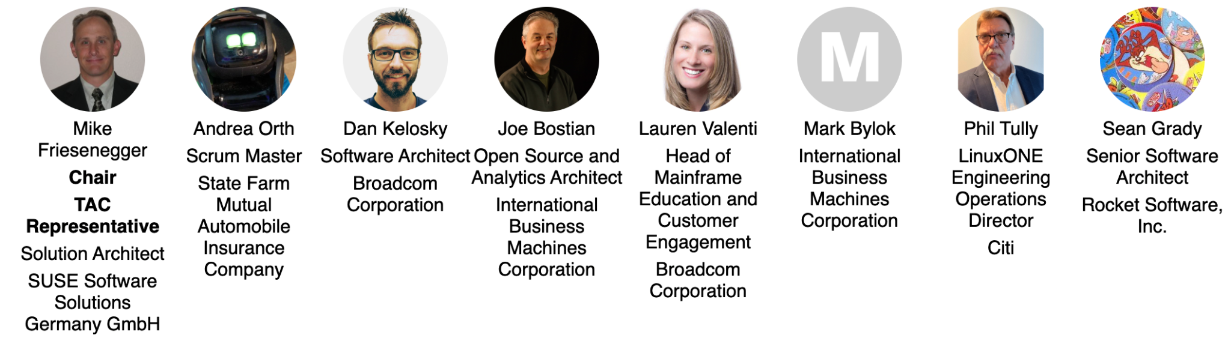
Technical Advisory Council (TAC) Representatives
Notes:
https://jmertic.github.io/committee-gallery/open-mainframe-project-tac

Slide 19
Appointing your TAC representative
(Platinum Members only)
As a Platinum Member, you are entitled to appoint a representative from your organization to serve on the TAC. Expectations of this include..
Attending twice monthly meetings ( generally 2nd and 4th Thursdays of the month at 1:00pm US Eastern Time ).
Serve as an advisor to one or more hosted projects or working groups.
Availability for time-to-time for strategic discussions and calls.
ACTION: To appoint your representative, please file a request at servicedesk.openmainframeproject.org, and have the representatives create an LF ID.
You can change your representative at any time by making a request at servicedesk.openmainframeproject.org.

Slide 20
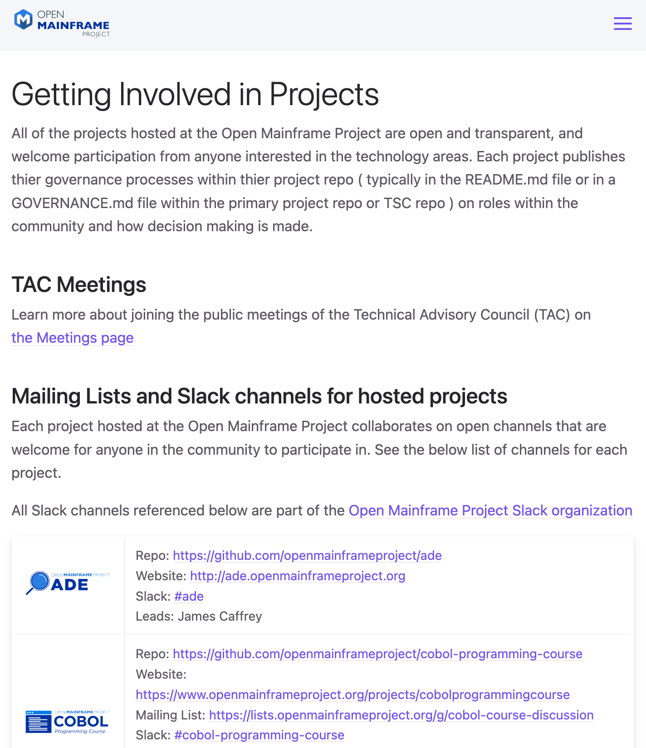
Contribute to Our Projects - anyone can!
Contribute to an existing project:
Submit a PR with a bugfix or new feature
Pick existing GitHub issue as a sample project
Integrate with a new app / contribute plugin
Help improve project documentation
Submit additional test cases
Join the TSC discussion: dev mailing list, conf calls
Get involved with the TAC or Working Group:
DevOps / CI expertise always useful
Interest / expertise in security especially welcome
Join the TAC discussions: mailing list, conf calls, working groups
More information at tac.openmainframeproject.org/engagement

Slide 21
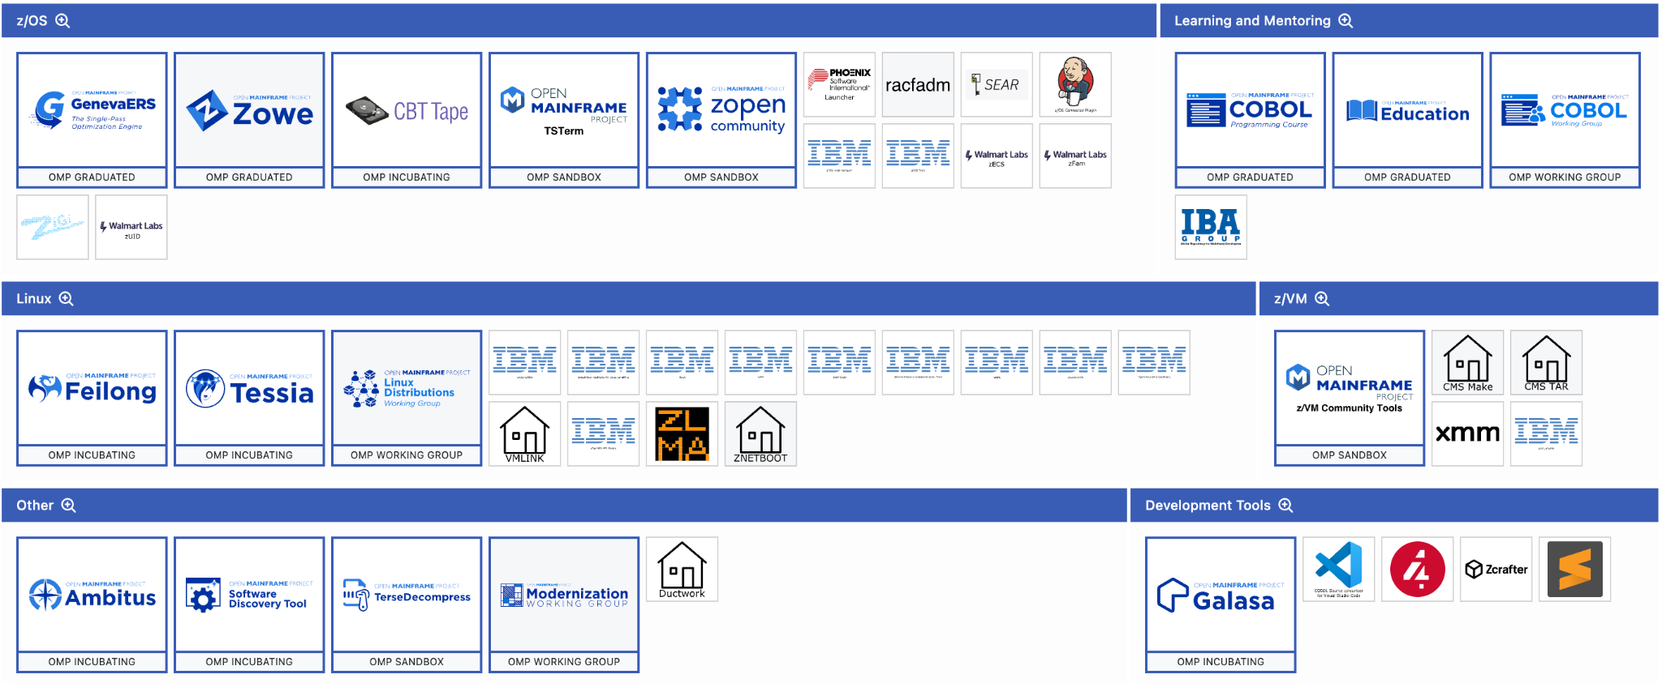
Landscape of Open Source Projects Only on Mainframe
Source: landscape.openmainframeproject.org/projects
Notes:
The ecosystem of open source on mainframe continues to grow, thanks to the work of the open source community on mainframe.
Source: https://landscape.openmainframeproject.org/projects

Slide 22
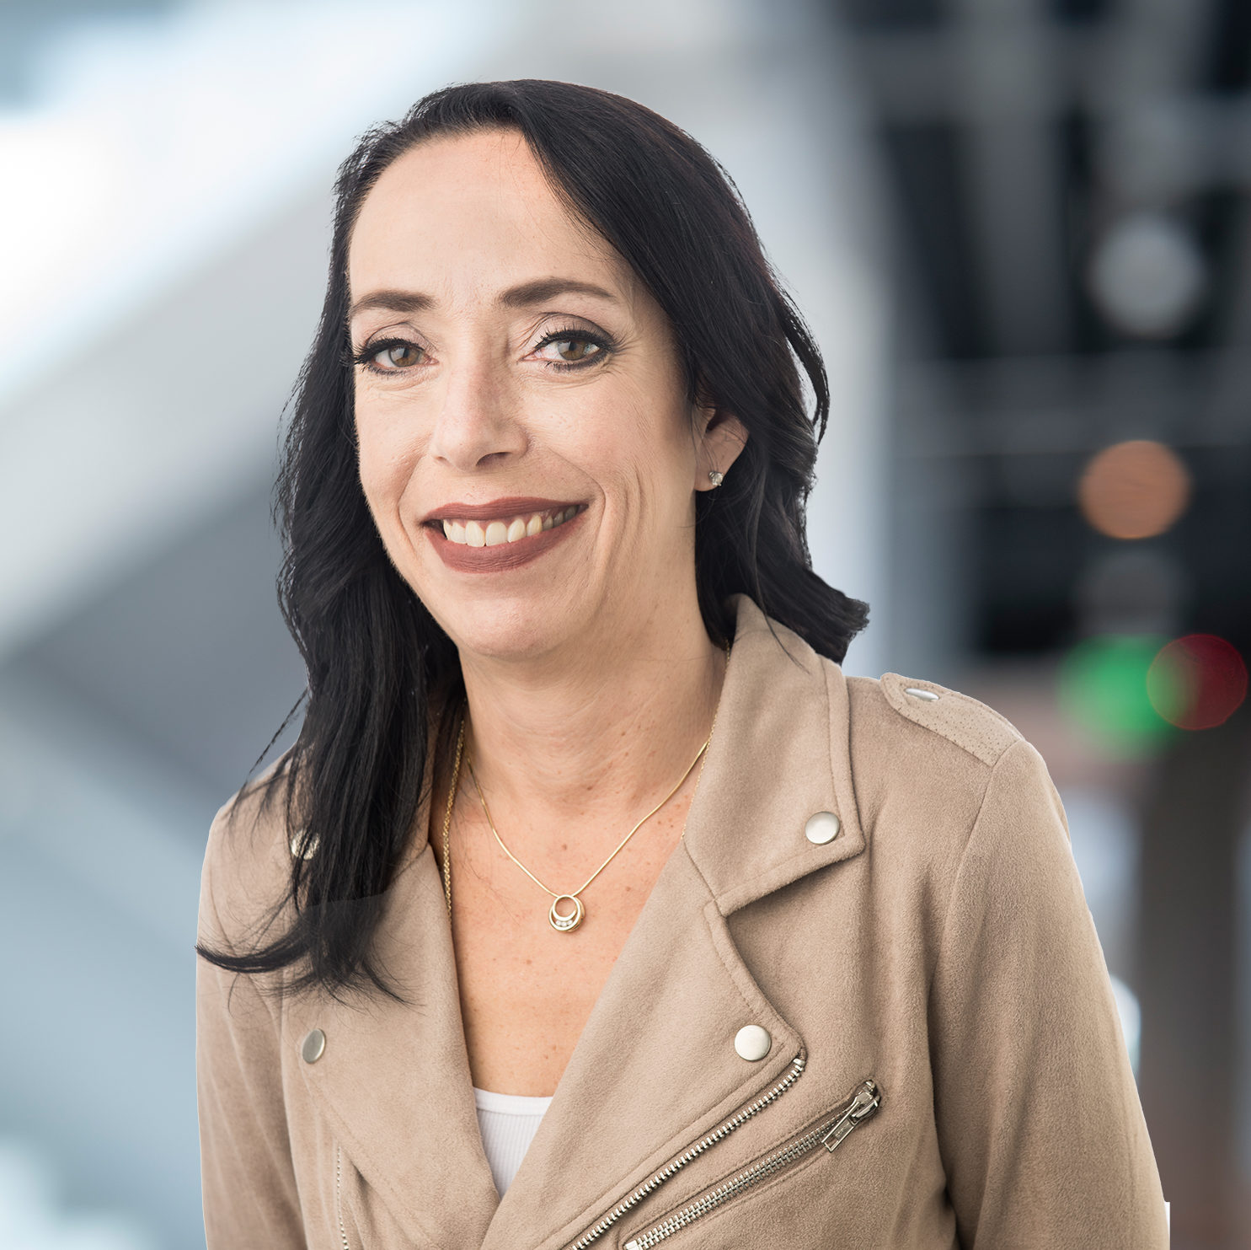
Marketing Committee
The Open Mainframe Project Marketing Committee is open to all Open Mainframe Project members and is charged with defining and executing the marketing and outreach strategy.
Voting members of the Marketing Committee consist of one representative from each Platinum member and one annually elected representative from all other classes of membership. Any member is welcome to attend and participate in the discussions and work
Meets monthly on the first Thursday, 3:00 PM to 4:00 PM ET
All are invited to attend these calls and encouraged to join the Marketing Committee mailing list for more information:
https://lists.openmainframeproject.org/g/omp-marketing
Add Monthly Marketing Meeting to your Calendar Now.
Donna Hudi
Marketing Committee representative for
Academic Institution, Associate, and Silver Member Membership class
Chief Marketing Officer at Phoenix Software
Donna has more than 30 years of financial service, technology, marketing, and executive management experience spanning the asset management, software development, consulting, and non-profit industries. Prior to joining Phoenix Software as their Chief Marketing Officer, she served as the Executive Director and Chief Operating Officer for SHARE Association, the first and largest independent technology association user group. Prior to joining SHARE, she served in various leadership positions where she provided a wide‐range of strategic, technology, operational, and marketing guidance and support..

Slide 23
Appointing your Marketing Committee representative
(Platinum Members only)
As a Platinum Member, you are entitled to appoint a representative from your organization to serve on the Marketing Committee. Expectations of this include..
Attending monthly meetings ( generally 1st Thursdays of the month at 2:00pm US Eastern Time ).
Collaborate on marketing and outreach activities.
Availability for time-to-time for strategic discussions and calls.
ACTION: To appoint your representative, please file a request at servicedesk.openmainframeproject.org, and have the representatives create an LF ID.
You can change your representative at any time by making a request at servicedesk.openmainframeproject.org.

Slide 24
Academic Institution, Associate, and Silver Member Marketing Committee representative
(Academic Institution, Associate, and Silver Members only)
Per the Open Mainframe Project charter, Section 5(a)(ii), the Academic Institution, Associate, and Silver Member class is entitled to elect…
one representative elected by the Silver, Academic Institution and Associate Members as a class.
The Academic Institution, Associate, and Silver Member class elects a new representative during the month of December to serve a term from January 1st through December 31st of that calendar year.
ACTION: Look for details regarding the election in November.
If you have any questions about this process or the role, please contact us at servicedesk.openmainframeproject.org.
Donna Hudi
Marketing Committee representative for
Academic Institution, Associate, and Silver Member Membership class
Chief Marketing Officer at Phoenix Software
Donna has more than 30 years of financial service, technology, marketing, and executive management experience spanning the asset management, software development, consulting, and non-profit industries. Prior to joining Phoenix Software as their Chief Marketing Officer, she served as the Executive Director and Chief Operating Officer for SHARE Association, the first and largest independent technology association user group. Prior to joining SHARE, she served in various leadership positions where she provided a wide‐range of strategic, technology, operational, and marketing guidance and support..

Slide 25
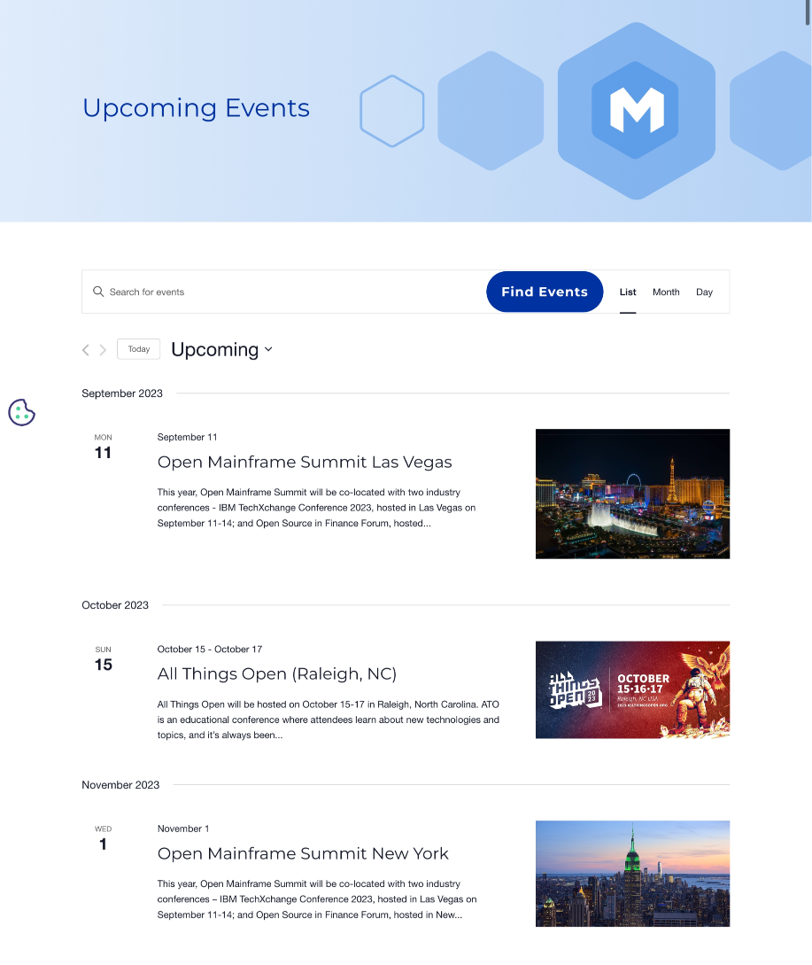
Keep up on Open Mainframe Project Events!
All webinars and events, both in-person and virtual, that Open Mainframe Project will have a presence at will be showcased on our events page.
If you are at an event, contact us to request a booth branding kit with a booth sign, stickers, and more!

Slide 26
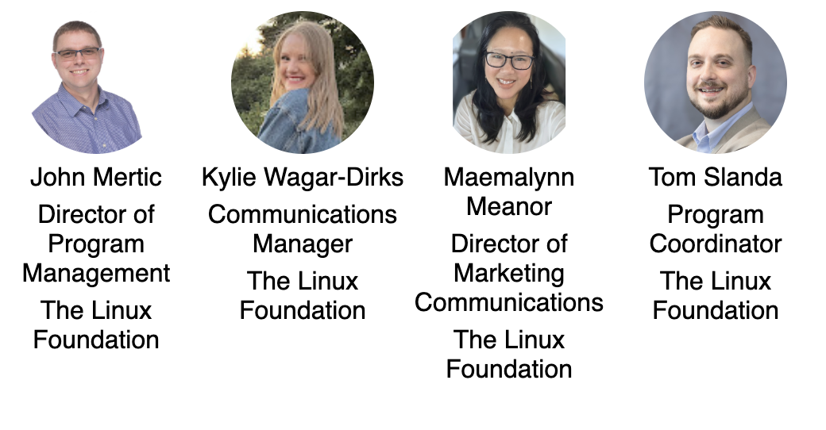
Open Mainframe Project staff
Contact us at members.openmainframeproject.org

Slide 27
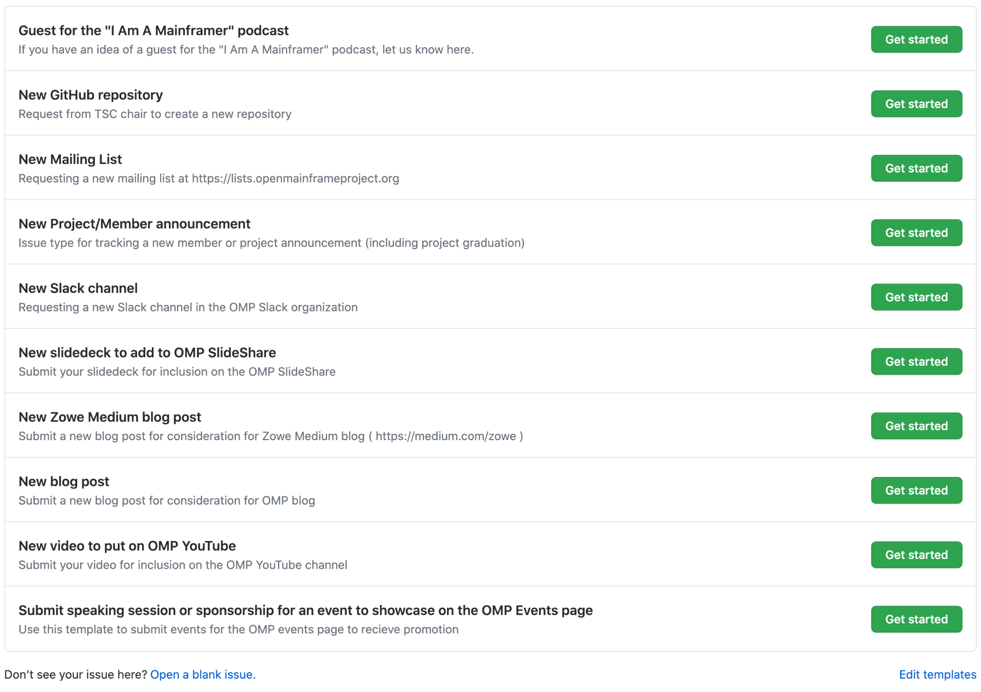
Engaging the Open Mainframe Project staff
Member requests can be made at members.openmainframeproject.org
Community and project requests can be made at servicedesk.openmainframeproject.org

Slide 28
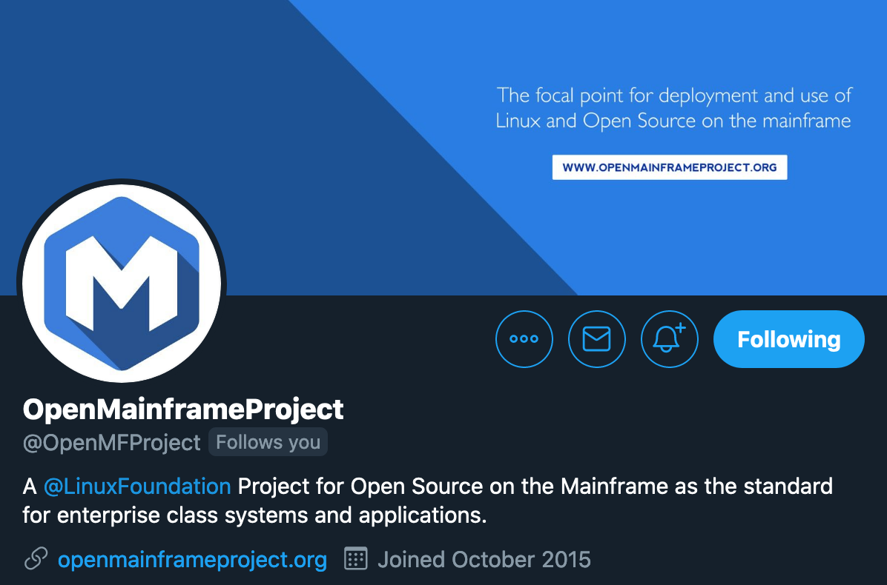
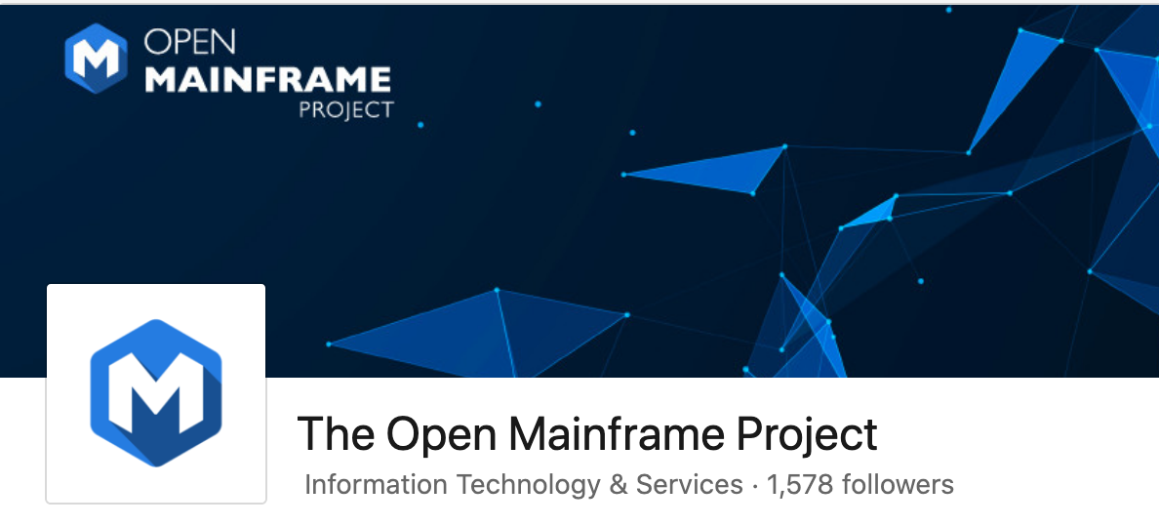
Make sure you are following us on social!
Follow us on LinkedIn at https://www.linkedin.com/company/the-open-mainframe-project
Follow us on Twitter at https://twitter.com/OpenMFProject
And sign up for the Open Mainframe Project newsletter to keep up to date on project happenings

Slide 29
Leveraging your membership benefits

Slide 30
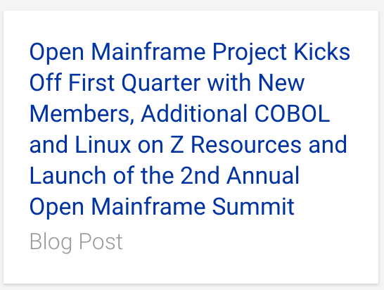
Announcing your membership
We will include your company in an upcoming momentum press announcement. These are typically done quarterly and timed around events for maximum impact.
ACTION: Please provide 1-2 sentences on your company, name of a spokesperson, and a quote to include in the press announcement. Submit request to members.openmainframeproject.org.
Please note that these announcements are often picked up by press and media, and there may be requests for briefings.

Slide 31







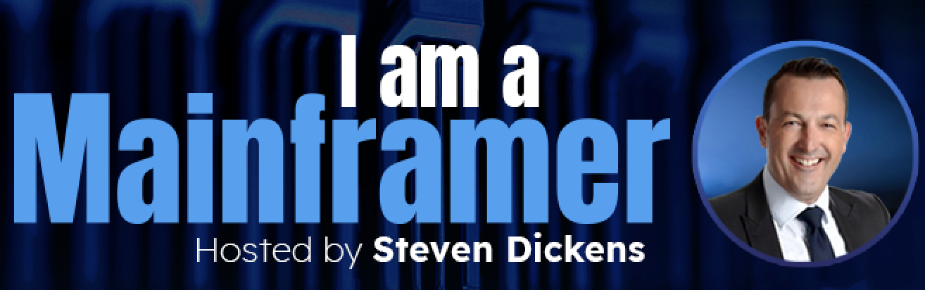
Participate in Outreach Activities
We focus on ensuring our members can advance their thought leadership on open source on the mainframe through our extensive media reach.
ACTION: Key opportunities to leverage now:
Submit a guest blog post to the Open Mainframe Project blog and/or Linux.com. Member contributed content must be vendor neutral & talk about an interesting trend or problem in the space.
Provide a guest for the "I Am A Mainframer" podcast series
Share potential spokespersons who would be interested in participating in other contributed articles, videos, podcasts, and events.
Share your news pertaining to one of our projects or your work in the open source on mainframe community for us to amplify and/or offer a quote.
Share events you will be at so we can promote your presence and talks relating to Open Mainframe Project.
5000+
followers
3000+
followers
1100+ global media articles in 2021 from 5 press announcements

Slide 32
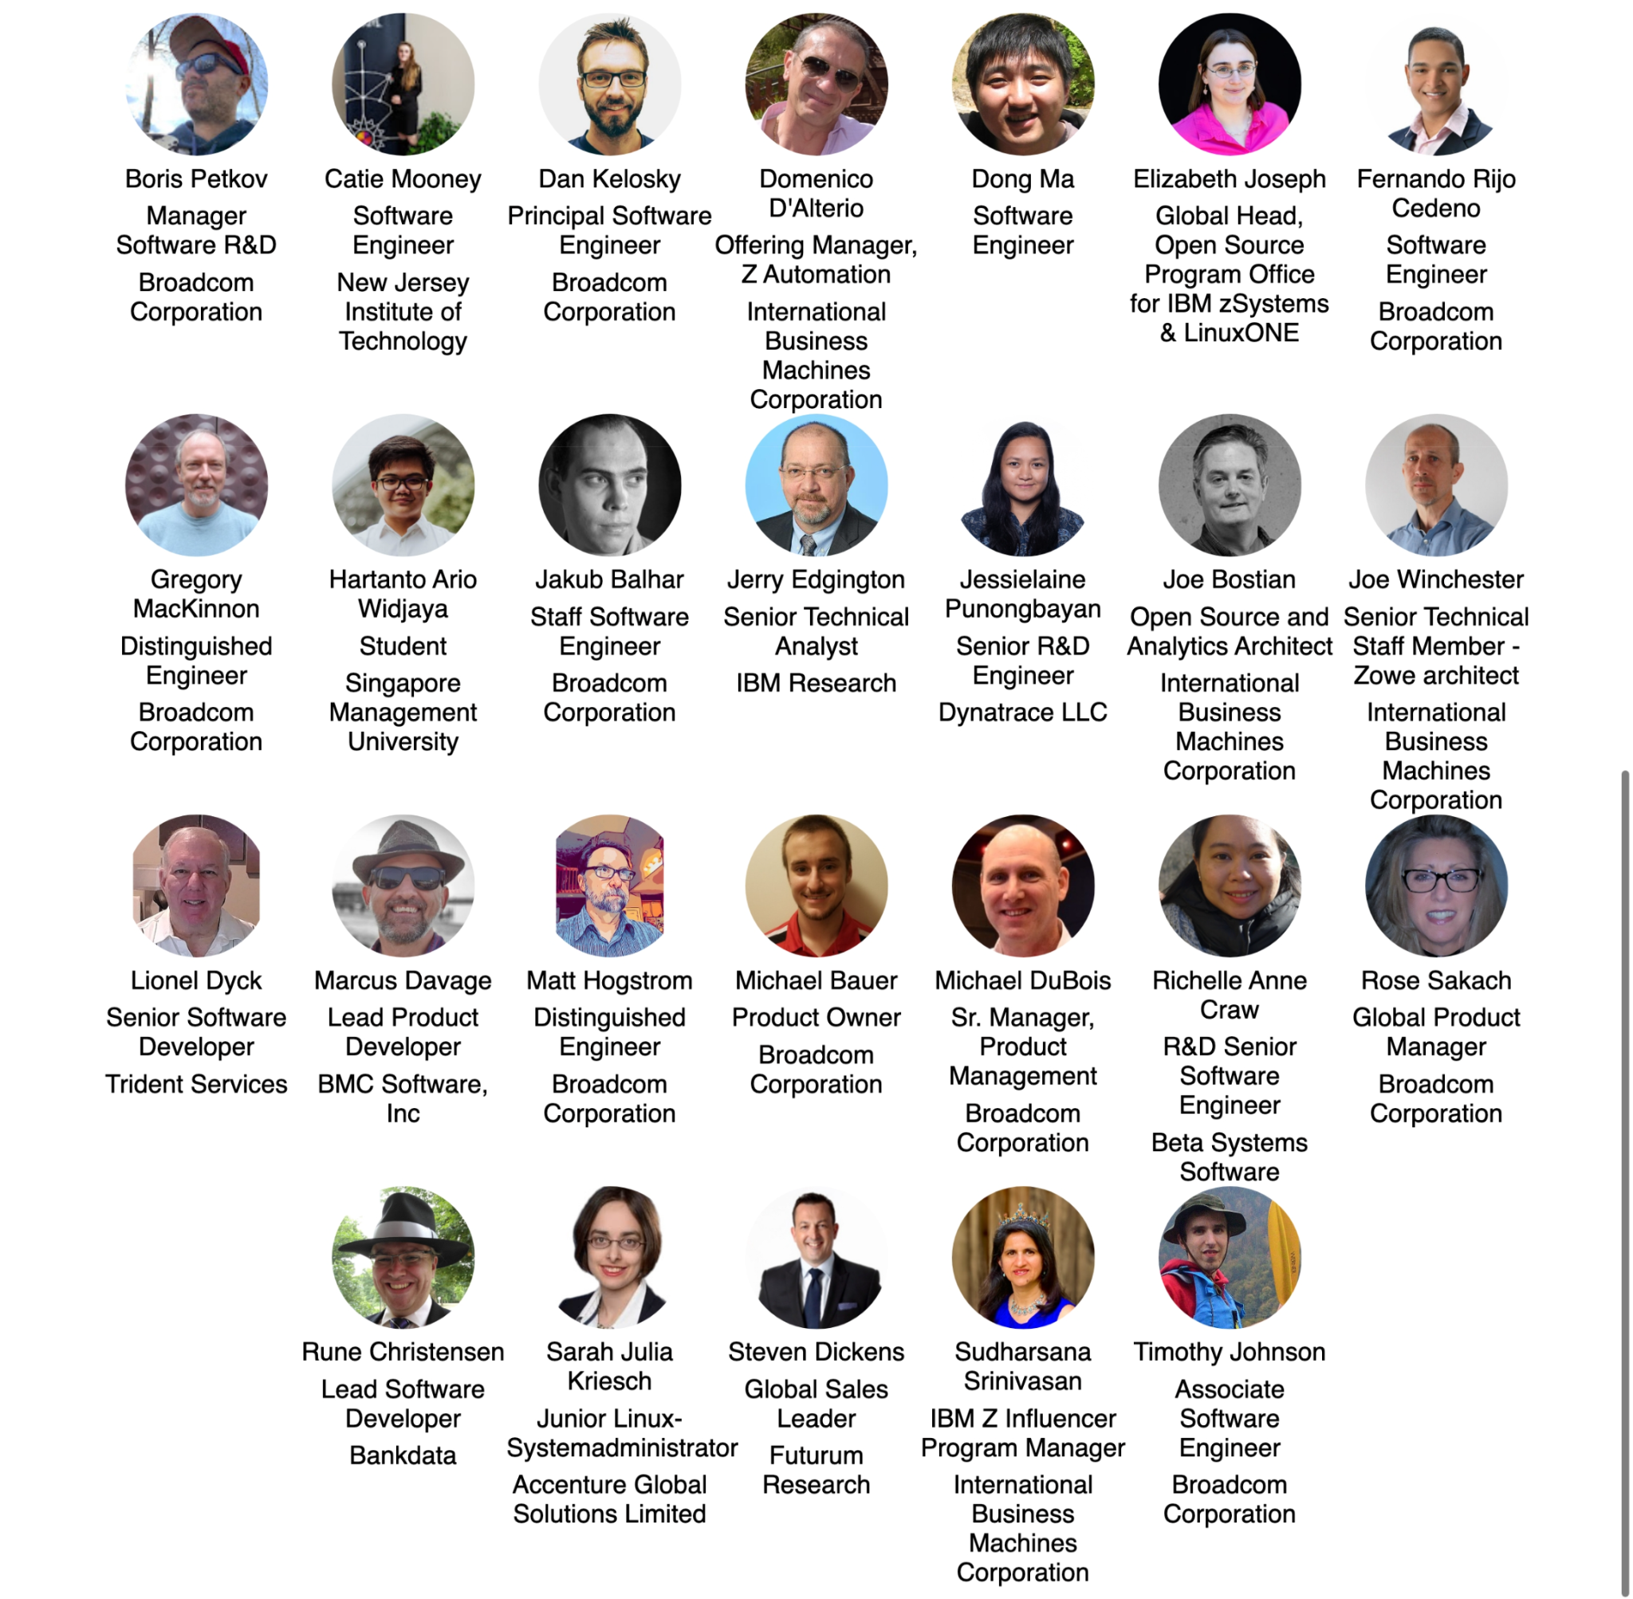

Meet the Open Mainframe Project Ambassadors
Open Mainframe Project Ambassadors are individuals who are passionate about the mainframe technology, recognized for their expertise, and willing to help others learn about it and community. Successful ambassadors are people such as bloggers, influencers, evangelists who are already engaged with an Open Mainframe project in some way including contributing to forums, online groups, community events, etc.
ACTION: If you would like an ambassador to speak at your event, please contact pr@openmainframeproject.org with the name of the conference, date and links.
Notes:
https://jmertic.github.io/committee-gallery/open-mainframe-project-ambassadors

Slide 33
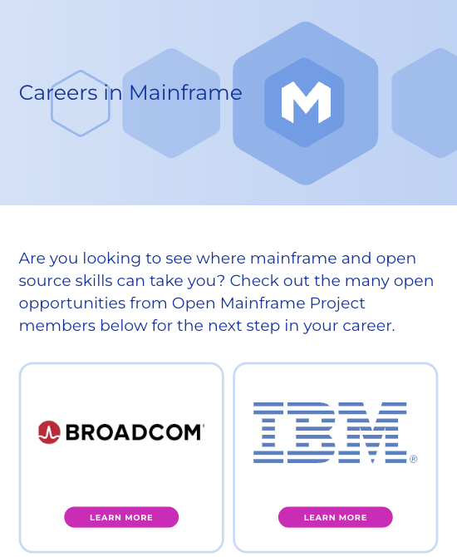
Showcase your career opportunities in mainframe
openmainframeproject.org/resources/careers
Showcase of Open Mainframe Project members who are hiring for mainframe positions
Not a job board - links to each member’s job listings
ACTION: Provide a link to your job listings specific to mainframe positions

Slide 34
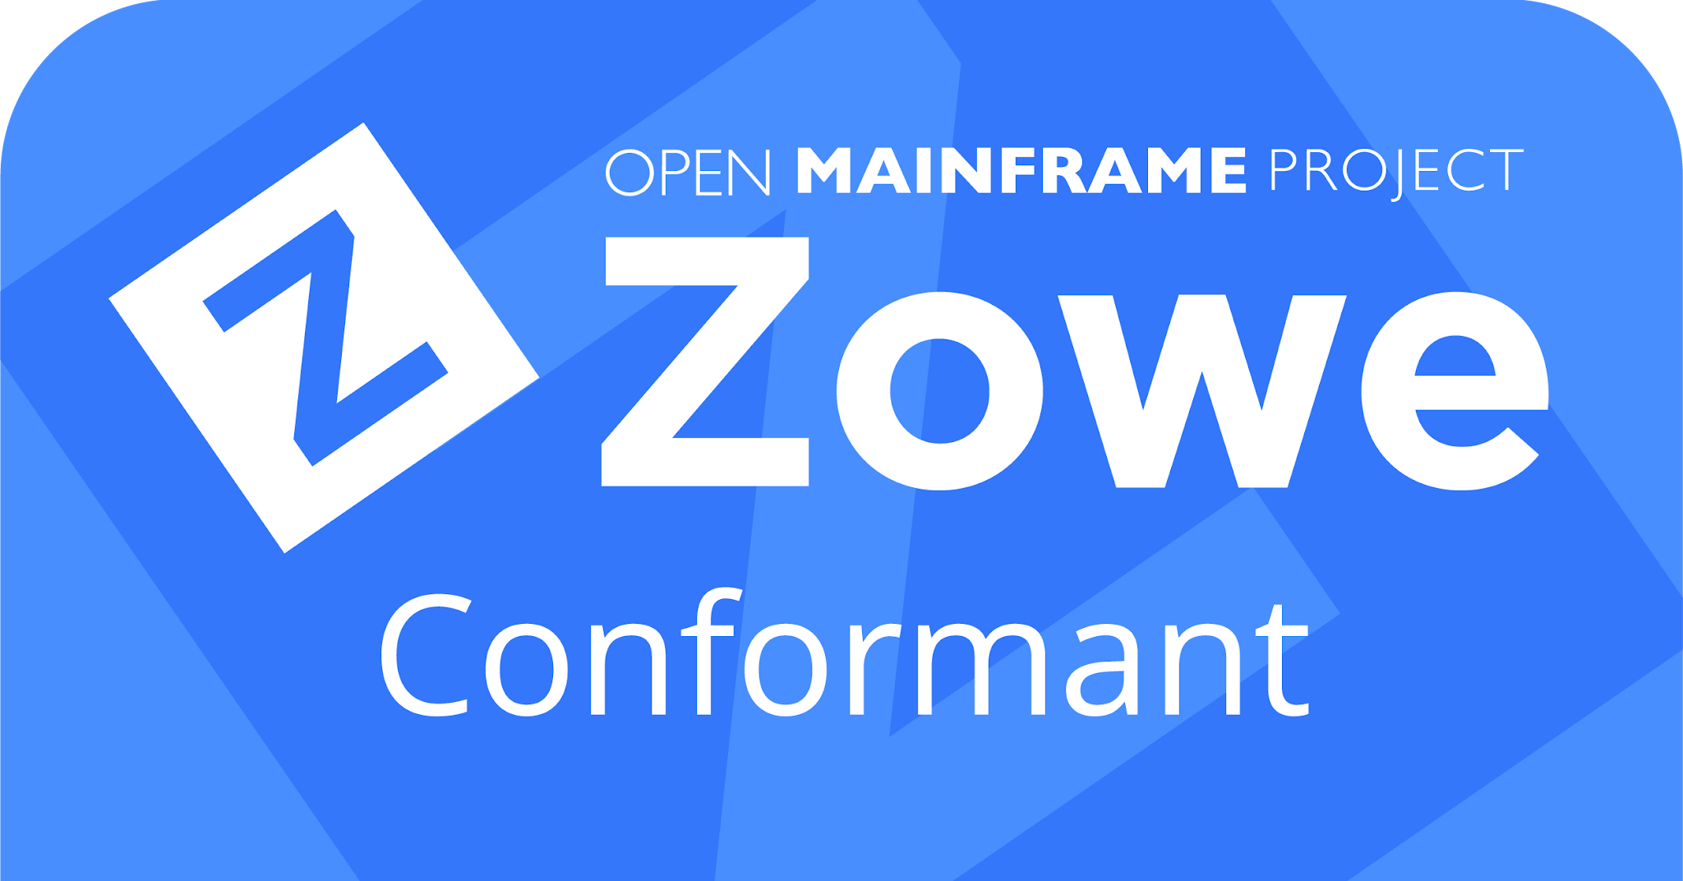
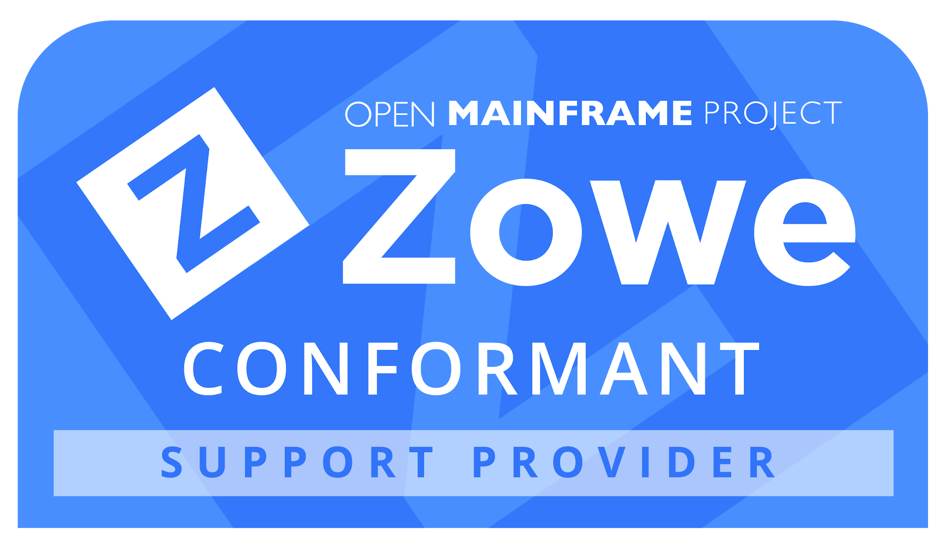
Join the Zowe Conformance Program
Zowe Conformance Program enables vendors to showcase their offerings based on Zowe, as well as their capabilities in supporting Zowe end-users.
Zowe Support Provider Conformance Program gives vendors the ability to showcase their Zowe support competencies.
Benefits
Your offering and logo listed in the Zowe Conformant offering directory or Zowe Conformant Support Provider directory and showcased in Zowe outreach materials
Exclusive branding marks to use in your product materials
Participation in the Zowe Advisory Council (ZAC)
PR announcement for new organizations providing offerings
Post a guest blog post on your offering on the Open Mainframe Project and Zowe blog
Fees are waived for Open Mainframe Project members
More details at https://www.openmainframeproject.org/projects/zowe/conformance

Slide 35
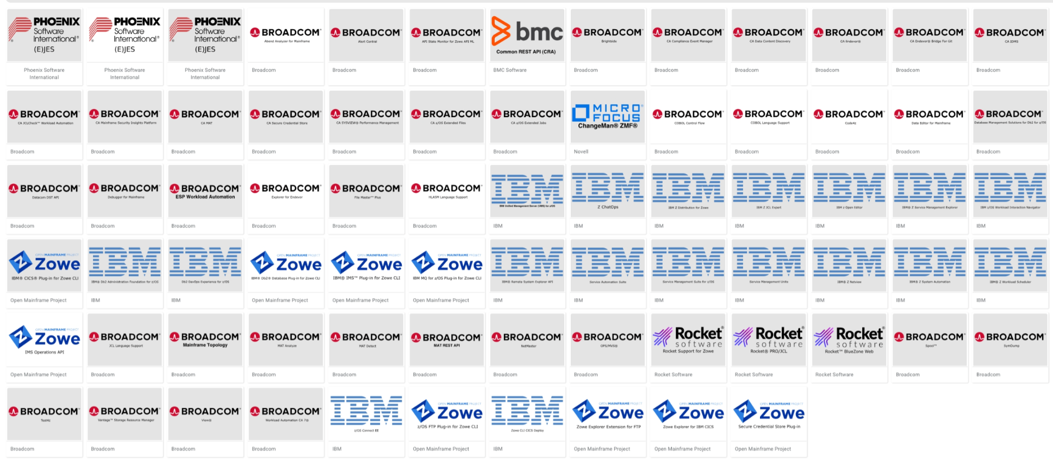
70+ unique Zowe Conformant offerings
Notes:
https://landscape.openmainframeproject.org/card-mode?category=zowe-conformant&grouping=no&embed=yes&style=logo

Slide 36
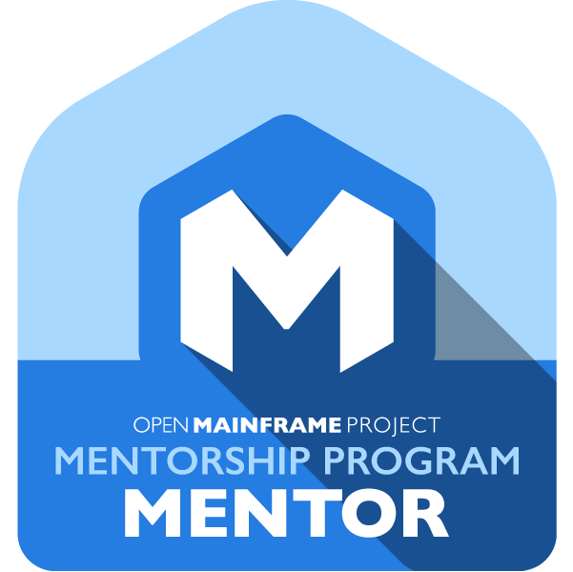
Host a Mentorship
Open Mainframe Project funds mentorships for students to bring new talent into mainframe through contributions to open source. These mentees have made huge impacts on hosted projects such as Zowe, Feilong, COBOL Programming Course, and more, as well as broad open source projects such as Alpine Linux, CloudFoundry, Kubernetes, and more. More than 1600+ students globally applied for a mentorship in 2024.
Members can provide a mentorship and be a mentor, which is funded by the Open Mainframe Project. This provides a unique opportunity to find new talent.
Contact mentorship@openmainframeproject.org if you are interested.

Slide 37
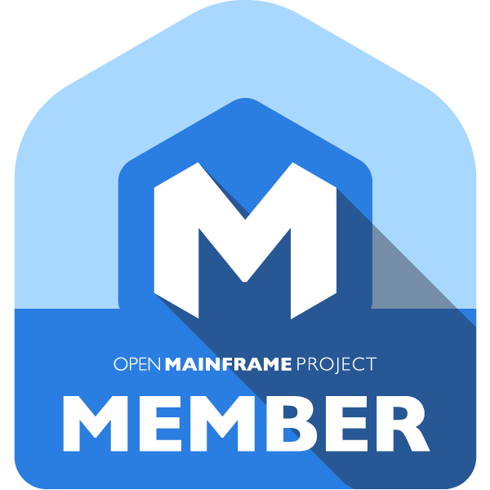

Open Mainframe Project and The Linux Foundation Logos
**Download Logos.
Contact trademark@linuxfoundation.org with any questions. Please review our brand trademark policy here and overview here.
Latest version of this deck posted monthly at openmainframeproject.org/membership-overview

Slide 38
Thank you for supporting open source on mainframe!
Find the latest version of this deck at openmainframeproject.org/membership-overview

